Slide 1


NYC
TAXI
6.12.18

Slide 2




MEET THE TEAM
Peleg
“Snake Eye”
Amon
Guy
“Machine Gun”
Gourevitz
Ram
“The Butcher”
Penkar
Head Chief Executive
VP
Global HQ
Director
Team leader
VP Development R&D
Junior
Co-Founder
Head of Space Launch

Slide 3

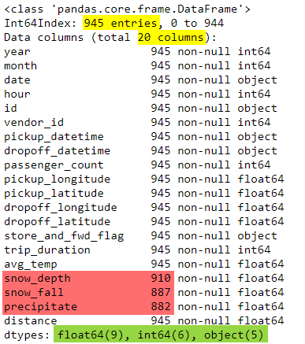
THE DATA SET

Slide 4




THE BUSINESS TARGET
To provide a recommendation system for a taxi driver
that predicts its next trip
based on
Duration (min)
Distance (mile)
Time (hours)
Precipitate (inch)

Slide 5
MISSING VALUES & IMPUTATION
In small dataset
“T” = missing values
Read “T” as NaN
Find NaN in 3 columns
Find most frequent value
Impute values - no drops
CHANGES IN FEATURES
“date” (format: yyyy-mm-dd)
split the day only
“day” as number
“day” as object (day name)
“trip duration” in seconds
“trip duration” in minutes
+
Renaming the columns to relevant names with unit signs

Slide 6
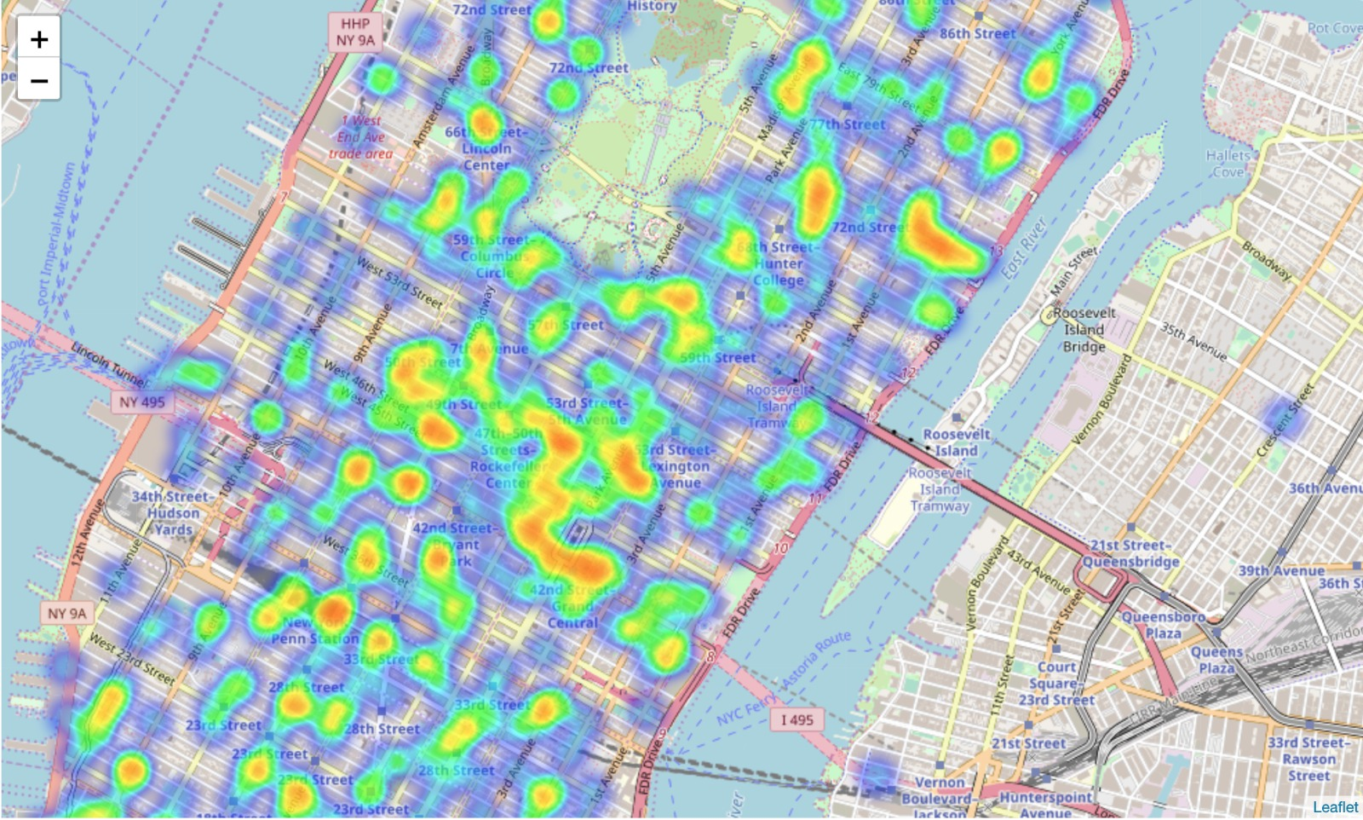
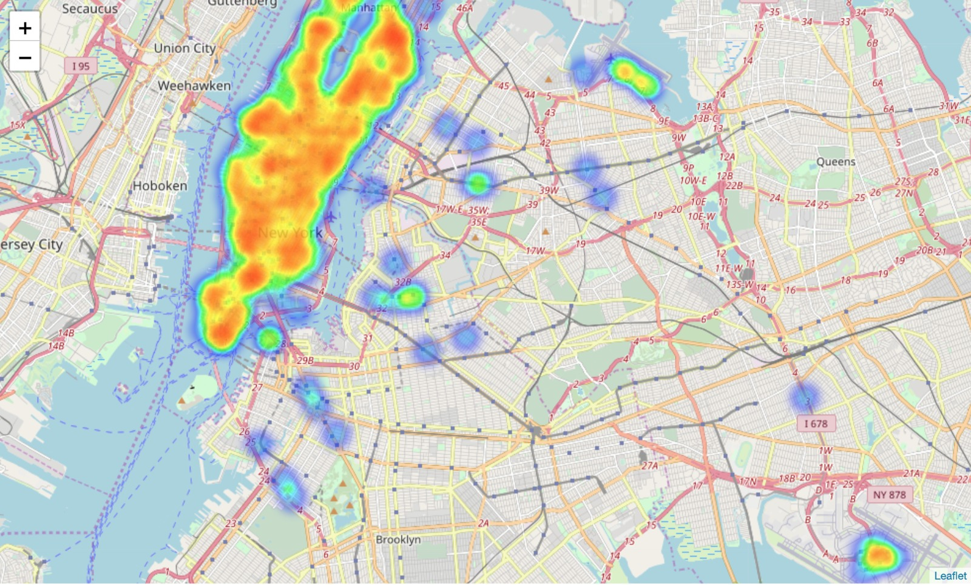
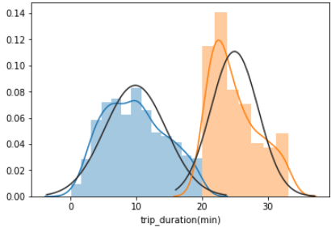
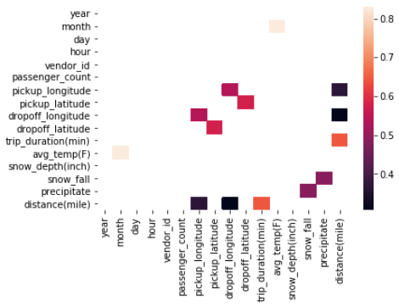
VALUES OF FINDINGS

Slide 7



THE NEXT STEP
Model type
CLASSIFICATION
REGRESSION
Predict Y
is the next trip is longer than the avg duration
the duration of the next ride
Optimizing the number of taxis
Lowering fuel
costs
Sub-goals

Slide 8

NYC
TAXI

